Slide 1
Data Visualization & Interpretation
Febin.A.Vahab

Slide 2
SESSION 1 -PLAN
Contact Sessions(#) | List of Topic Title | Text/Ref Book/external resource
1 | Introduction Exploiting the Digital age Visualisation as a Discovery tool Visualisation skills for the masses The Visualisation methodology Visualisation design objectives Exploratory vs. explanatory analysis | T1 Ch 1 T2 Ch1

Slide 3
LET US DISCUSS ☺
Scenario 1

Slide 4
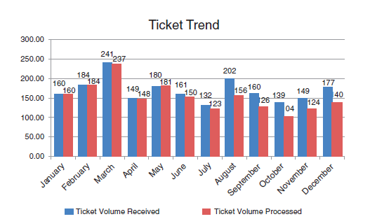
Ticket trend-Showing data-
Ineffective

Slide 5
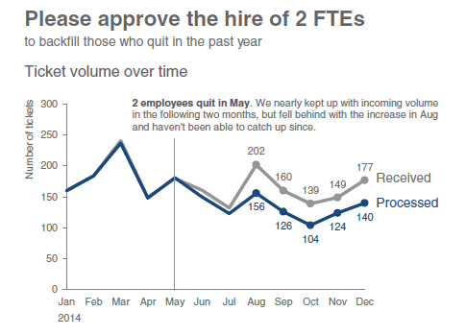
Ticket trend
Effective Storytelling with data

Slide 6
LET US DISCUSS ☺
Scenario 2

Slide 7
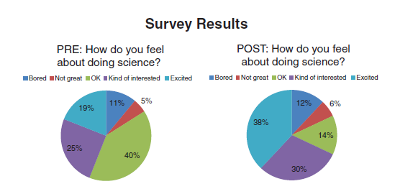
Survey Results-Showing data

Slide 8
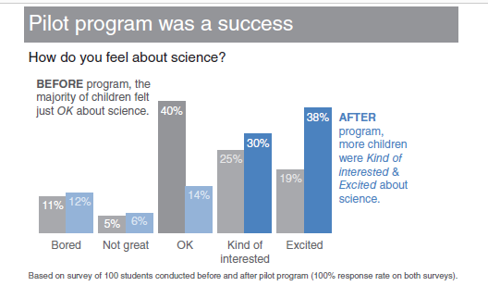
Survey Results-Story Telling with data

Slide 9
LET US DISCUSS ☺
A few “current” visuals

Slide 10
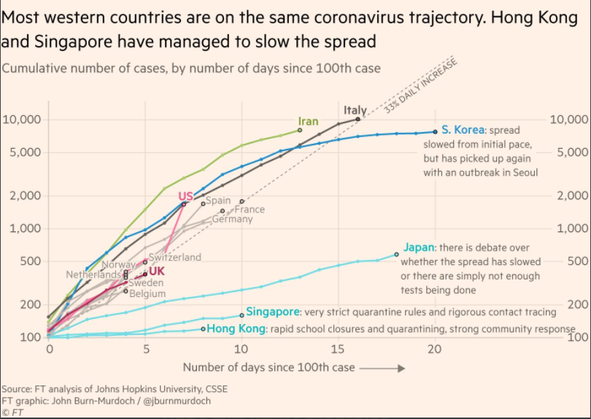

Slide 11
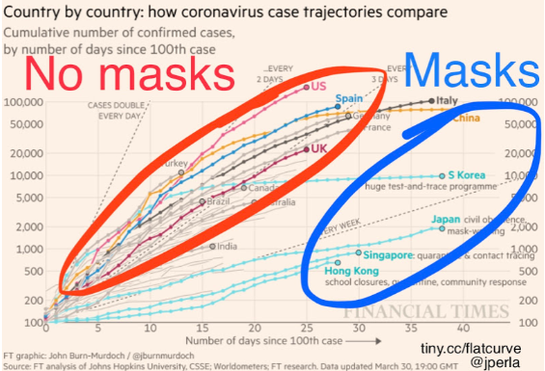

Slide 12
CANVAS Discussion

Slide 13
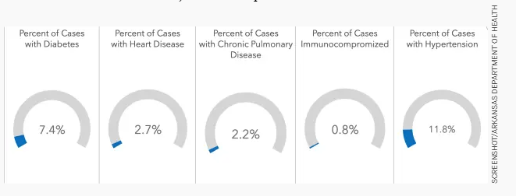
Missing Context

Slide 14
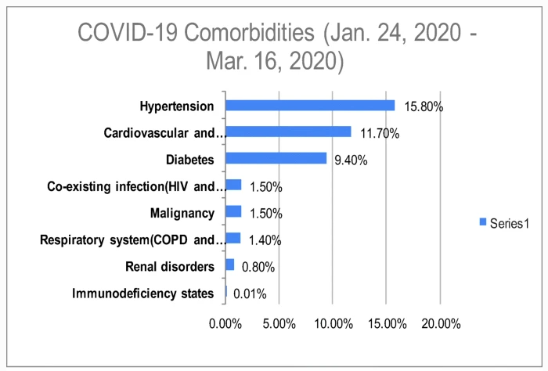
With Context

Slide 15
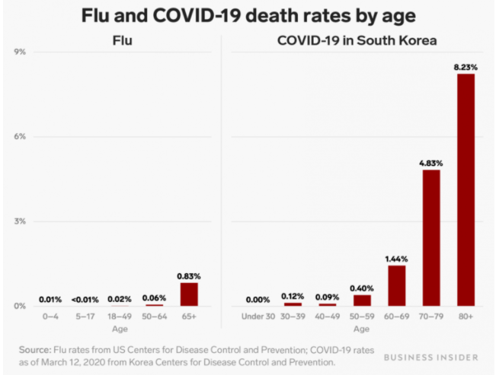
Wrong Data Comparison

Slide 16
Story telling with Data
Being able to tell stories with data is a skill that’s becoming ever more important in our world of increasing data and desire for data driven decision making.

Slide 17

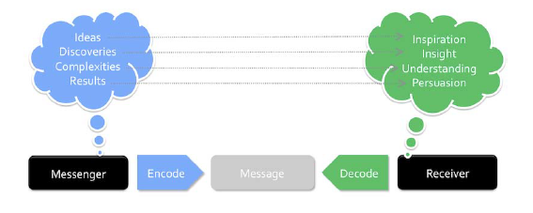
Definition
“ Data visualization is the use of visual representations to explore, make sense of, and communicate data.” - Data visualization expert, Stephen Few

Slide 18
What is Data Visualisation?
Data Viz is using pictures to represent data.
Process of turning information into pictures for a specific purpose.

Slide 19

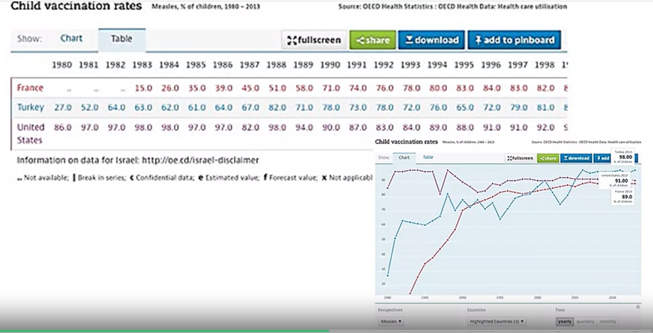
Why do we Visualize data?
Picture superiority effect-Human Brain and Data Viz

Slide 20
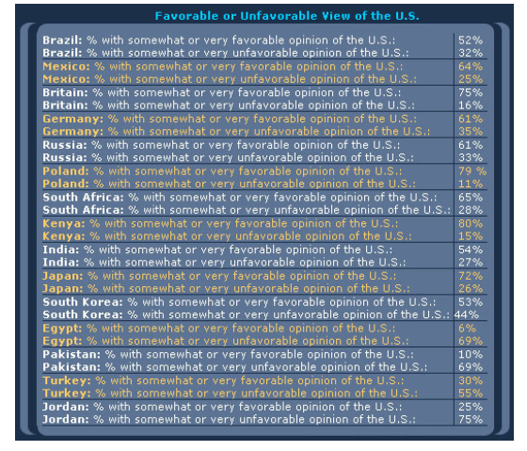
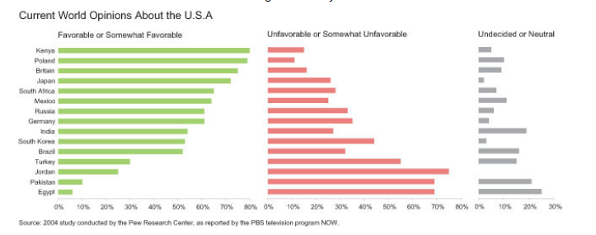
Why do we Visualise data
Seeing the big picture

Slide 21
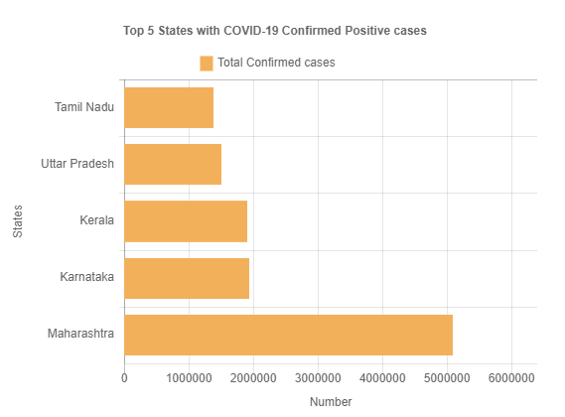
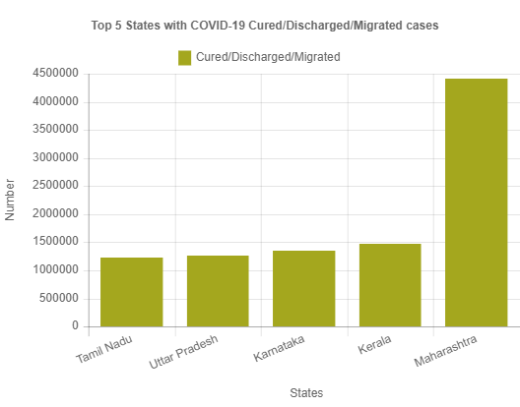
Why do we Visualise data
Seeing the big picture
COVID-19 INDIA:Last Updated:10 May 2021:data.gov.in

Slide 22
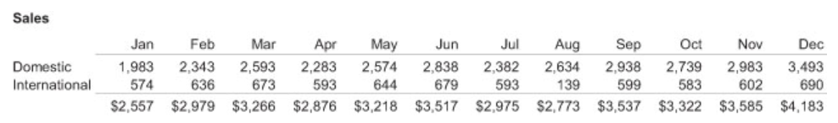
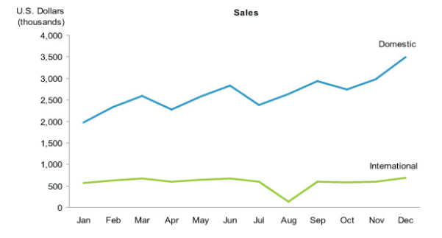
Why do we Visualise data
Easily and rapidly comparing values
Seeing patterns among values
Comparing patterns

Slide 23
Quotes-on Purpose
“The ability to take data—to be able to understand it, to process it, to extract value from it, to visualize it, to communicate it—that's going to be a hugely important skill in the next decades” –
Hal Varian, Google's chief economist
“The purpose of visualization is insight, not just picture.” –
Ben Shneiderman, Data visualization pioneer

Slide 24

Visualization as a discovery tool
“The greatest value of a picture is when it forces us to notice what we never expected to see” - John W Tukey

Slide 25
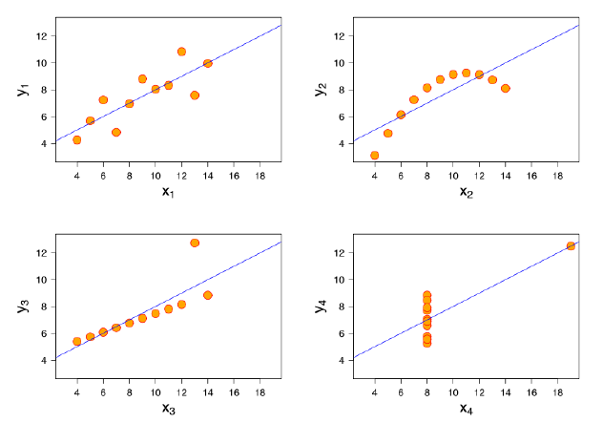
Visualization as a discovery tool
• the general tendency about a trend line in X1, Y1
• the curvature pattern of X2, Y2
• the strong linear pattern with single outlier in X3, Y3
• the similarly strong linear pattern with an outlier for X4, Y4

Slide 26
Visualization Design Objectives
Strive for form and function (style over substance)
Justifying the selection of everything we do
Creating accessibility through intuitive design
Never deceive the receiver
Notes:
1.1 Fundamentally, attractive form enhances function and the function portrays beauty through its effect.
1.2 Initially focus on securing the functional aspects of your visualization
2.1 Everything you do is thoroughly planned, understood, and reasoned.
2.2 We should consider the idea of deliberate design, which means that the inclusion, exclusion, and execution of every single mark, characteristic, and design feature is done for a reason
3.1 We don't want people to have to spend unnecessary time thinking about how to use or how to read and interpret something
3.2 Make sure that the efforts needed from the reader or user to understand how to use and interpret a visualization are ultimately rewarded with a worthy amount of insight gained
4.1 Avoid any significant distortion of the truth

Slide 27
Visualization Design Objectives
Strive for form and function (style and substance)
Help people make clear, accurate interpretations
Gain useful insights based on what they see.
Cognitive vs Perceptual Design Distinction

Slide 28
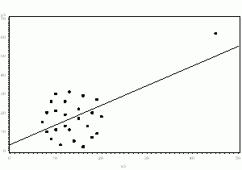
Visualization Design Objectives

Slide 29

Visualization Design Objectives

Slide 30
Visualization Design Objectives
Strive for form and function (style over substance)
Justifying the selection of everything we do
Creating accessibility through intuitive design
Never deceive the receiver
Notes:
1.1 Fundamentally, attractive form enhances function and the function portrays beauty through its effect.
1.2 Initially focus on securing the functional aspects of your visualization
2.1 Everything you do is thoroughly planned, understood, and reasoned.
2.2 We should consider the idea of deliberate design, which means that the inclusion, exclusion, and execution of every single mark, characteristic, and design feature is done for a reason
3.1 We don't want people to have to spend unnecessary time thinking about how to use or how to read and interpret something
3.2 Make sure that the efforts needed from the reader or user to understand how to use and interpret a visualization are ultimately rewarded with a worthy amount of insight gained
4.1 Avoid any significant distortion of the truth

Slide 31
Visualization Design Objectives
Justifying the selection of everything we do
"We're so busy thinking about if we can do things, we forget to consider whether we should.“
Everything you do must be thoroughly planned, understood, and reasoned

Slide 32
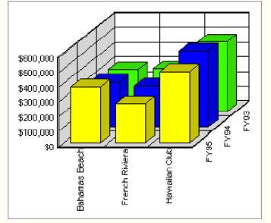
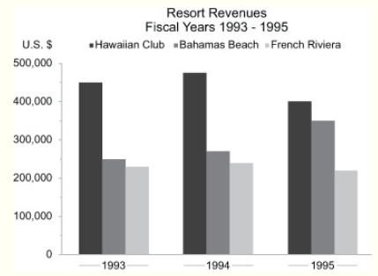
Example

Slide 33
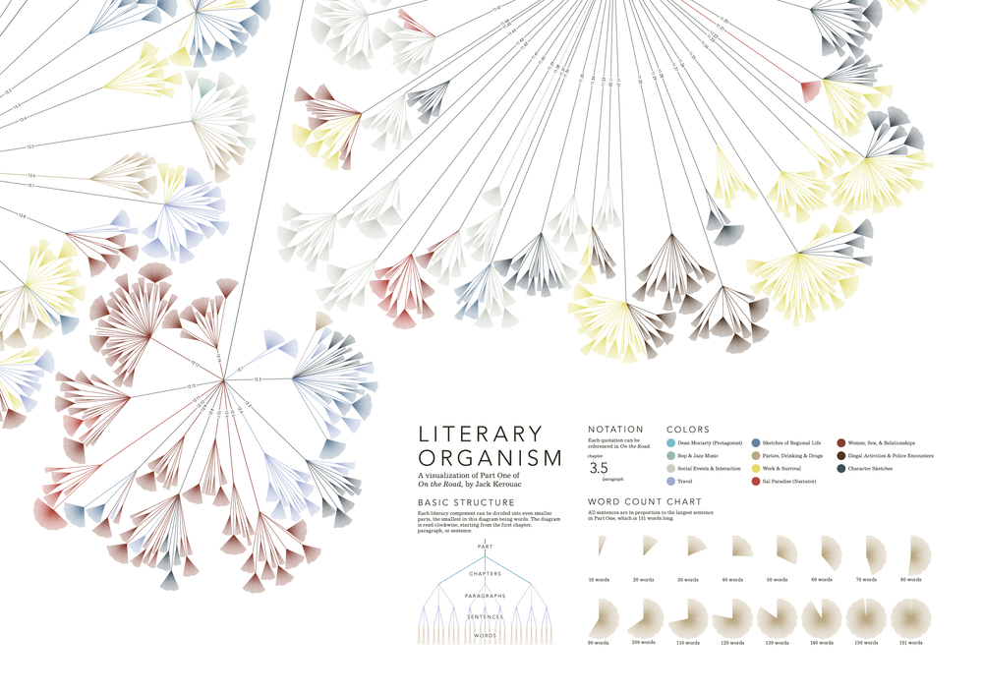
Visualization Design Objectives-Reading assignment
http://www.stefanieposavec.com/writing-without-words

Slide 34
Visualization Design Objectives
Strive for form and function (style over substance)
Justifying the selection of everything we do
Creating accessibility through intuitive design
Never deceive the receiver
Notes:
1.1 Fundamentally, attractive form enhances function and the function portrays beauty through its effect.
1.2 Initially focus on securing the functional aspects of your visualization
2.1 Everything you do is thoroughly planned, understood, and reasoned.
2.2 We should consider the idea of deliberate design, which means that the inclusion, exclusion, and execution of every single mark, characteristic, and design feature is done for a reason
3.1 We don't want people to have to spend unnecessary time thinking about how to use or how to read and interpret something
3.2 Make sure that the efforts needed from the reader or user to understand how to use and interpret a visualization are ultimately rewarded with a worthy amount of insight gained
4.1 Avoid any significant distortion of the truth

Slide 35
Visualization Design Objectives
Creating accessibility through intuitive design
"Overload, clutter, and confusion are not attributes of information, they are failures of design.“
It is important to create a distinction between accessibility and immediacy.

Slide 36
Visualization Design Objectives
Creating accessibility through intuitive design

Slide 37
Visualization Design Objectives
Strive for form and function (style over substance)
Justifying the selection of everything we do
Creating accessibility through intuitive design
Never deceive the receiver
Notes:
1.1 Fundamentally, attractive form enhances function and the function portrays beauty through its effect.
1.2 Initially focus on securing the functional aspects of your visualization
2.1 Everything you do is thoroughly planned, understood, and reasoned.
2.2 We should consider the idea of deliberate design, which means that the inclusion, exclusion, and execution of every single mark, characteristic, and design feature is done for a reason
3.1 We don't want people to have to spend unnecessary time thinking about how to use or how to read and interpret something
3.2 Make sure that the efforts needed from the reader or user to understand how to use and interpret a visualization are ultimately rewarded with a worthy amount of insight gained
4.1 Avoid any significant distortion of the truth

Slide 38
Visualization Design Objectives
4. Never deceive the receiver

Slide 39
Visualization Design Objectives
4. Never deceive the receiver
Avoid any significant distortion of the truth.

Slide 40

Visualization Design Objectives
4. Never deceive the receiver
Avoid any significant distortion of the truth.

Slide 41
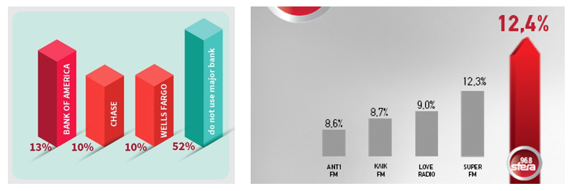
Visualization Design Objectives
4. Never deceive the receiver
Avoid any significant distortion of the truth.

Slide 42
Definition Revisited
Data Visualisation is
The representation and presentation of data that exploits our visual perception abilities in order to amplify cognition.

Slide 43
Next Session
Exploratory and Explanatory Analysis
Visualisation Context.

Slide 44

References
Knaflic, Cole. Storytelling With Data: A Data Visualization Guide for Business Professionals, Wiley, 2015
Chapter 1 : The importance of context
Chapter 3 : Clutter is your enemy

Slide 45
Interesting Reads
https://eazybi.com/blog/data_visualization_and_chart_types/
https://blog.hubspot.com/marketing/types-of-graphs-for-data-visualization#sm.000vodl7ch6rf7e112a2q13r9cno0
Why do we visualize quantitative data? https://www.perceptualedge.com/blog/?p=1897
http://www.storytellingwithdata.com/blog/2019/5/23/visualizing-artisanal-data
https://www.tableau.com/learn/articles/data-visualization
https://www.tableau.com/sites/default/files/media/designing-great-visualizations.pdf

Slide 46
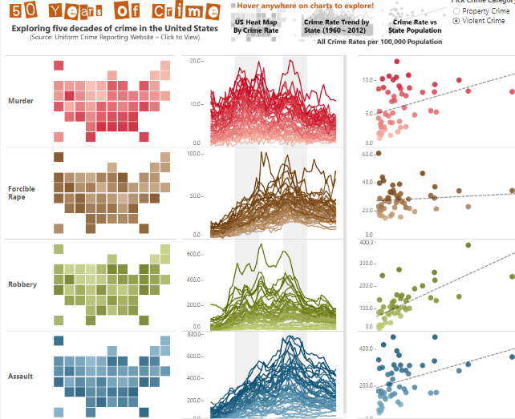
What is Data Visualisation?
Link

Slide 47
Thank You!

